Slide 1
Predicting Real GDP Change
Milestone 5 : Final Report
Economics Specialist Group
Izzat Adly
Ryan Bockmon
Quan Nguyen (Max)

Slide 2
Introduction
Our project focused on the application neural networks in the field of economics. We wanted to see how well our neural network design would perform when predicting real GDP change
For milestone 3, we managed to show that some long term variables are better than others as inputs for our model.
For milestone 4, we redesign the experiment to allow for optimal performance by our model.
For milestone 5, we wanted to see how well the model did when inputting all the data that we had.
Notes:
Our group focused how well neural networks perform when applied to problems in the field of economics. Specifically, we wanted to see whether our neural network model can predict real GDP change of an economy. In milestone 3, we managed to show that some long term variable inputs are better than others for our model. For milestone 4, we redesign the experiment to reach the optimal performance for our model. For the milestone 5 presentation, we will be looking at the performance of our model when inputting all of the data that we had into our model.

Slide 3
Outline
Data and data processing
NN architecture
Experimental setup
Milestone 3
Milestone 4
Milestone 5
Evaluation Method
Experimental Results/Discussion
Learning performance
Model performance based on countries for test data
Conclusion
Notes:
For our presentation, we will first go through the Data and data processing for our project. Followed by the neural network architecture that we designed and the experimental setup for milestone 3, 4 and 5 to provide context and comparisons between current and previous results. Then we will explain our evaluation method and what results came out of our experiment. Lastly, we will explain in the discussion and conclusion about the performance of our model when learning the data and how well it did when predicting based on country.

Slide 4
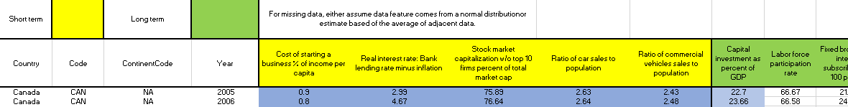
Data and data processing
CSV format
Independent variables are columns. (16 long term variables, 5 short term variables).
Each instance is either a training data or testing data.
8 interested countries.
Image 1: Example csv format
Notes:
Max
For each country, the training data is the first 13 years. The testing data is the last year.
Short-term variables are “Cost of starting a business % of income per capita”, “Real interest rate: Bank lending rate minus inflation”, “Stock market capitalization w/o top 10 firms percent of total market cap”, “Ratio of car sales to population”, and “Ratio of commercial vehicles sales to population”.
Long term variables are "Capital_Investment", "Labor_Force_Participation", "Fixed_Broadband",
"RandD", "Property_Rights", "Freedom_From_Corruption", "Fiscal_Freedom", "Business_Freedom",
"Labor_Freedom", "Monetary_Freedom", "Trade_Freedom", "Investment_Freedom", "Financial_Freedom",
"Economic_Freedom_Overall", "Pop_Above_65", "Savings_As_GDP"
Using the inputs appropriate to each milestone, the model estimated what the final economic growth could be. The result would then be compared with the actual economic growth of that year of that country, and mean absolute error would be computed.
While training and for testing, all values are divided by 100 as it seems to improve the model’s performance. All results are multiplied by 100 for better interpretation.

Slide 5
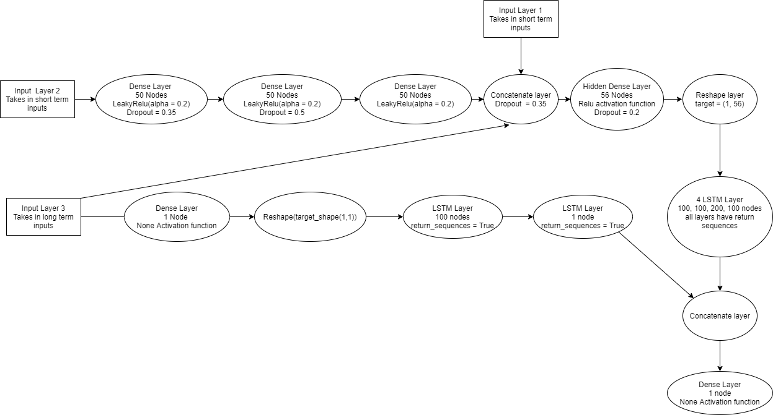
NN Architecture
Image 2: Example of our NN architecture
Notes:
Max
From this image, there are 3 places where inputs will get introduced to the model: Input layer 1, input layer 2, input layer 3, where the first 2 are short-term variables while the last consists of long term variables. First, short-term variables from input layer 2 will get trained with 3 dense layers with 50 nodes each. The activation function is LeakyReLU. LeakyReLU differs from ReLU in that if x < 0, x = x * alpha instead of 0. Alpha is 0.2 in this case. There are also dropout layer after the first and second cell with rate as 0.35, 0.5 respectively. Then, the output is concatenated to a newly introduced short-term variable inputs and long-term variables. On the other hand, long-term variables are also trained on a separate branch (the second on in the image) while the concatenate layer continue to train with Dense layer and 4 LSTM cells with 100, 100, 200, 100 nodes respectively. They are all followed by a Dropout layer with rate as 0.35. Finally, both branches get merged and reached the final Output layer. There is no activation function for the output layer.

Slide 6
Experimental Setup (Milestone 3)
Short Term variables
Long Term Variables
Country 1
1
1
1
1
1
1
1
Iteration 1
5
16
+
5
Country 1
1
1
1
1
2
1
1
5
16
Iteration 2
5
+
Notes:
Ryan
Thank you. I will now talk about the experimental setup. This slide goes over how we setup our experiment for milestone 3. The next slide will show how we set it up for milestone 4 and the slide after that will show the experimental setup for milestone 5 to show the difference on what we did between the milestones.
In milestone 3 we wanted to see how each of the long term variables impacted the model accuracy at predicting real GDP by country. We split the data into a training set and a testing set for each individual country. The training set consisted of the first N-3 data points while the testing set consisted of the last 3 data points. We then ran our model with each individual country and the 5 corresponding short term vailabes (depicted in blue) plus a single long term variable (depicted in orange). We then re-compiled and ran the model for each long term variable replacing the long term variable and evaluated the accuracy each iteration. So the first iteration we ran our model on country 1 plus the 5 short term variables and the first long term variable. Then accessed the accuracy of the model. The second iteration we ran out model on country 1 plus the same 5 short term variables and the second long term variable for that country and accessed the models accuracy. We repeated this process for every long term variable for each country.

Slide 7
Experimental Setup (Milestone 4)
Short Term variables
Long Term Variables
Country 1
Country 2
Country 3
.
.
.
Country 8
1
1
1
1
1
1
1
Iteration 1
5
16
+
5
Country 1
Country 2
Country 3
.
.
.
Country 8
1
1
1
1
2
1
1
5
16
Iteration 2
5
+
Notes:
Ryan
For milestone 4 we combined all data from each of the countries instead of looking at each country individually. Increasing the number of data points for each variable by 8 fold. For milestone 4 we still only looked at individual long term variables. Replacing each one for each iteration and accessed the accuracy of our model for each long term variable and compared those results to milestone 3.

Slide 8
Experimental Setup (Milestone 5)
Short Term variables
Long Term Variables
Country 1
Country 2
Country 3
.
.
.
Country N
1
2
3
16
+
+
+
+...+
5
Notes:
Ryan
For milestone 5 we combined all of the countries plus all the short term and long term variables and ran a single model to see the overall accuracy of our model. We then compared those results to both milestone 3 and milestone 4. For future work we would have liked to look at every possible combination of variables to see which set of variables resulted in the model with the highest accuracy.

Slide 9
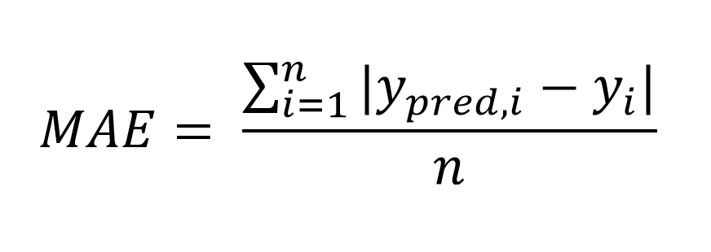
Evaluation Method
Equation 1: Mean Absolute Error
Notes:
For evaluation purposes, we used Mean absolute error to evaluate the performance of our model as seen in the equation on this slide. It is the average of the errors between the prediction of our model and the actual result.

Slide 10
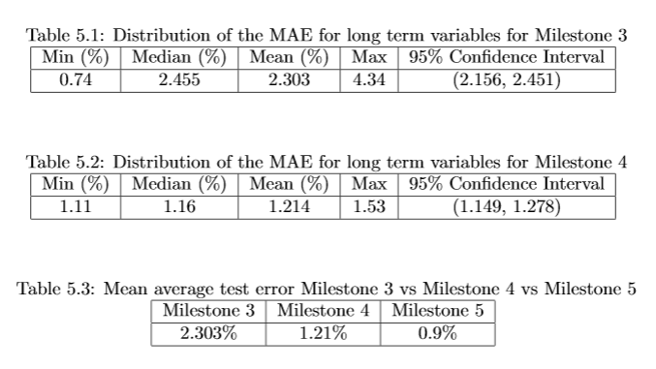
Experimental Results/Discussion
Notes:
Ryan
Table 5.1 shows the highlights of the results we got in milestone 3. Where the minimum error for a single variable was a 0.74%, max of 4.34%, Median of 2.455% and Mean 2.302%. The 95% confidence was between 2.156 and 2.451.
Table 5.2 shows the highlights of the results we got in milestone 4. The minimum error we had on a single variable was 1.11% and the max was 1.53% with a Median of 1.16% and mean of 1.214%. The 95% confidence was between 1.149, and 1.278.
Table 5.3 shows the mean error of each of models from milestone 3 to milestone 5.
We decreased the average error of our model with each milestone. From an average error around 2.3 for milestone 3 to an average error around 1.2 for milestone 4 to an average error around 0.9 for milestone 5. This was expected as the number of data points increased for every milestone. However, our understanding of how individual variables are at predicted real GDP decreased with every milestone, because we combined more data together each iteration.

Slide 11
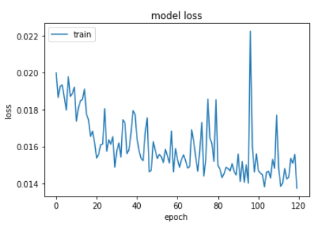
Performance based on epochs
Notes:
This graph shows loss of our model for milestone 5. It had a downward trend in the error on the training data set. Even though there were moments of high variance in the loss graph, the model managed to use all the variables input to learn how to predict the change in real GDP accurately.

Slide 12
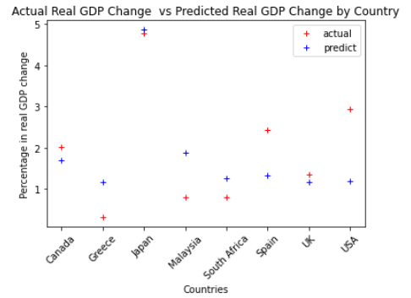
Model performance based on countries for test data
Notes:
The above figure displays the prediction of the model on test data based on the countries. For Japan, UK, and Canada, our model accurately predicts the real GDP change within a 0.5% percent error. But for other countries like Greece, Malaysia, Spain, and USA the model either over estimated the real GDP change like in Greece and Malaysia, or underestimated the real GDP change like in Spain and USA. From this information, we can count that the model managed to accurately predict the change in real GDP for 4 out of the 8 countries in our data set.

Slide 13
Conclusion
By inputting all 5 short term variables and 16 long term variables, our model reached optimal performance.
The model was can learn from data and predict on unknown data accurately.
To further improve upon the findings, designing a similar but simpler neural network is encouraged.
Using statistical methods to clean and preprocess the data properly is also very important for future studies.
Notes:
The conclusion of milestone 5, is that we can reach optimal performance of our model by inputting the 5 short term variables and all 16 long term variables together. Our model showed capabilities in both learning from the training data and predicting on unknown test data. We can further improve our model in future work by designing similar but simpler neural network models, and use statistical methods to further improve quality of the data that we have.

Slide 14
Questions?

